Slide 1
NODE and Express
JavaScript for Backend

Slide 2
Why we need backend?
Static website files
Dynamic Website files
Example- todo list: with backend and without backend

Slide 3
Modules
OS
PATH
FS (file server)
HTTP
etc…

Slide 4
-: Some Hands on Code examples :-
(open vs code)

Slide 5
HTTP MODULE
Createserver
What is request?
What is response?
Server.listen
Routing through paths
etc..

Slide 6
JSON Basics
Status Codes
HTTP Methods

Slide 7
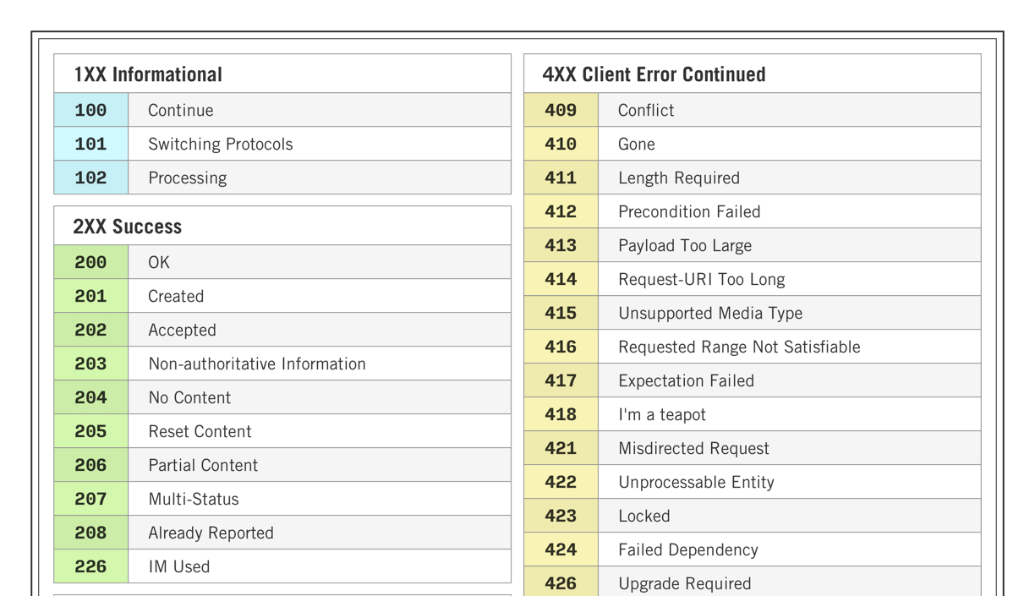
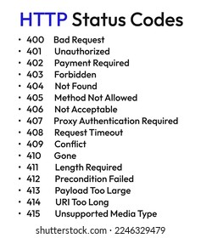
STATUS CODES

Slide 8
GET
POST
PUT
DELETE

